Slide 1

Natural Language Processing:
A brief introduction
Enter into browser: https://bit.ly/nlp-python-2020
GitHub repository: http://bit.ly/nlp-repo-2020
Jaren Haber, PhD Massive Data Institute
October 19th, 2020 Georgetown University
Notes:
Special thanks to Laura Nelson, David Bamman, Geoff Bacon, and Ben Gebre-Medhin for help with these slides and the notebooks

Slide 2
Agenda today
Introductions (~5 mins)
Slides: Introduction to NLP (~40 mins)
Break (5 mins)
Notebook: Practice with preprocessing (~50 mins)

Slide 3
Introductions
Instructor
Participants (breakouts)
Name
Affiliation
Any immediate projects or use cases? (Briefly)
Familiarity with Python? (Beginner, Intermediate, Advanced)

Slide 4
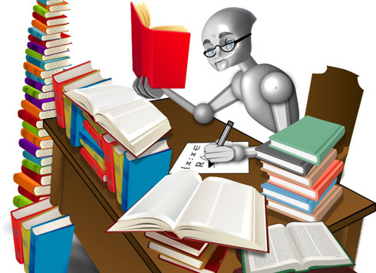
Goals of this workshop
Build intuitions about using text as data
Understand at a high-level:
how a few primary CTA methods work
what kinds of questions they answer
how to design and implement a CTA project
Gain practice with:
preprocessing text data
dictionary methods
NLTK and Scikit-learn
Acquire resources for further learning

Slide 5
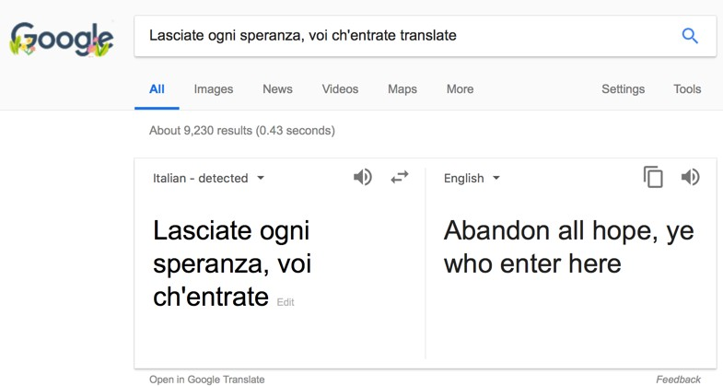
Machine translation
Notes:
Slide borrowed from David Bamman’s INFO 256 course: http://people.ischool.berkeley.edu/~dbamman/info256.html

Slide 6
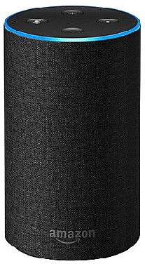
Speech recognition
“Alexa, do you believe in ghosts?”
Notes:
Slide borrowed from David Bamman’s INFO 256 course: http://people.ischool.berkeley.edu/~dbamman/info256.html

Slide 7
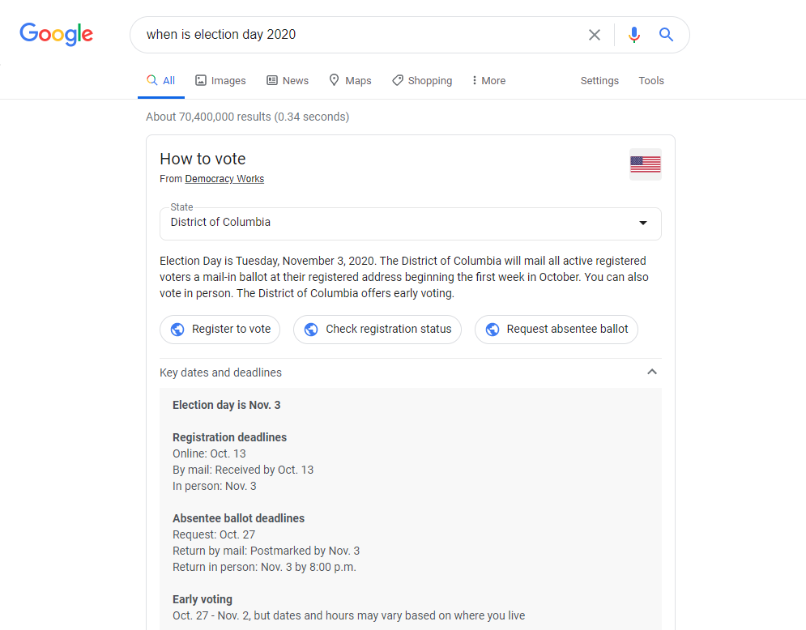
Question answering

Slide 8






Software/Libraries
NLTK
10
Notes:
Slide borrowed from David Bamman’s INFO 256 course: http://people.ischool.berkeley.edu/~dbamman/info256.html

Slide 9
NLP is interdisciplinary
Artificial intelligence
Machine learning (ca. 2000—today); statistical models, neural networks
Linguistics (representation of language)
Social sciences/humanities (models of language at use in culture/society)
Notes:
Slide borrowed from David Bamman’s INFO 256 course: http://people.ischool.berkeley.edu/~dbamman/info256.html

Slide 10
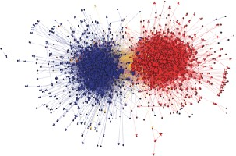
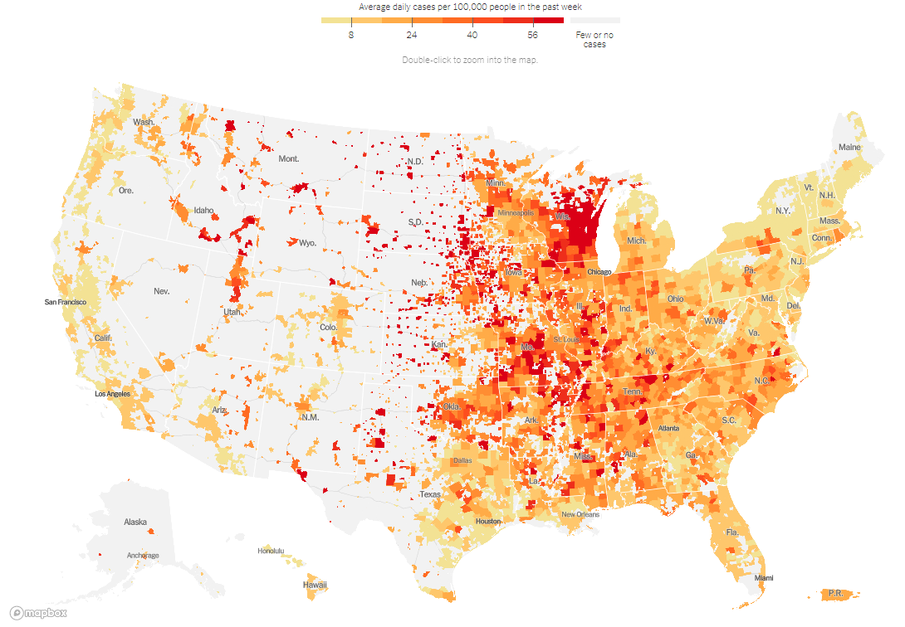
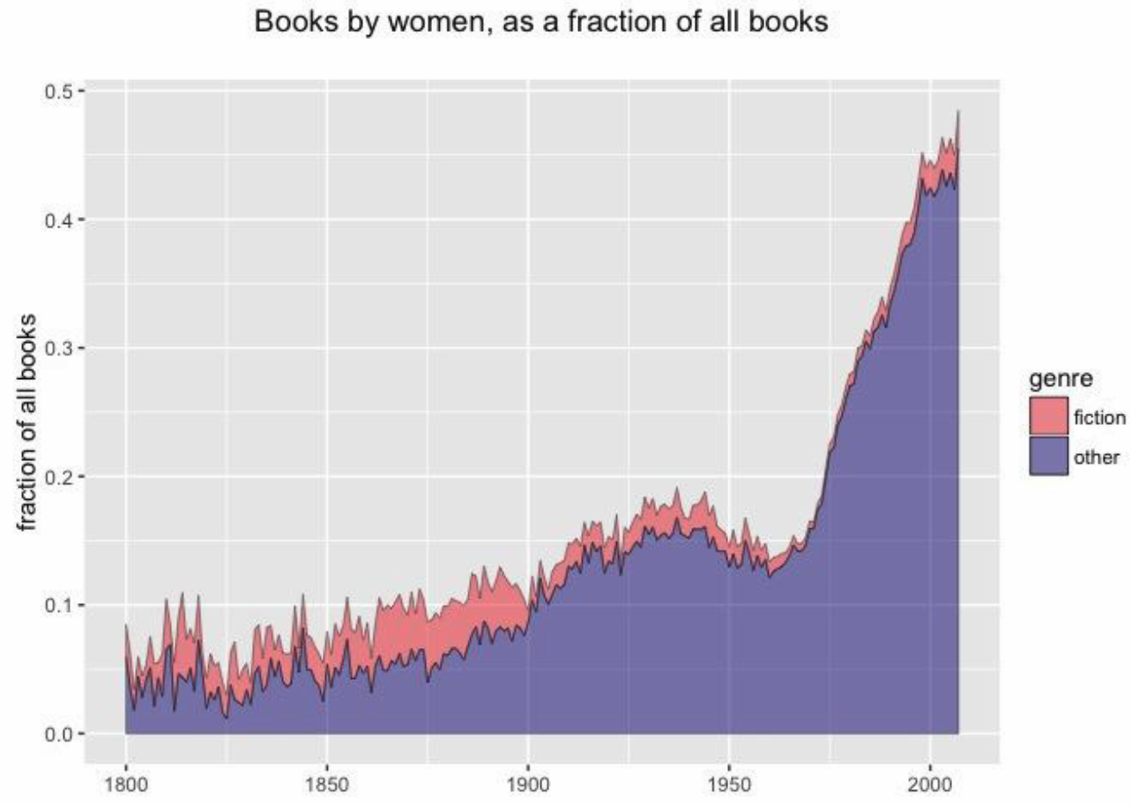
Computational Journalism
Computational Social Science
Adamic and Glance 2005
Covid in the U.S.: Latest Map and Case Count, NY Times (Oct 16, 2020)
Computational Humanities
Underwood et al. 2018
Notes:
Slide inspired by those from David Bamman’s INFO 256 course: http://people.ischool.berkeley.edu/~dbamman/info256.html

Slide 11
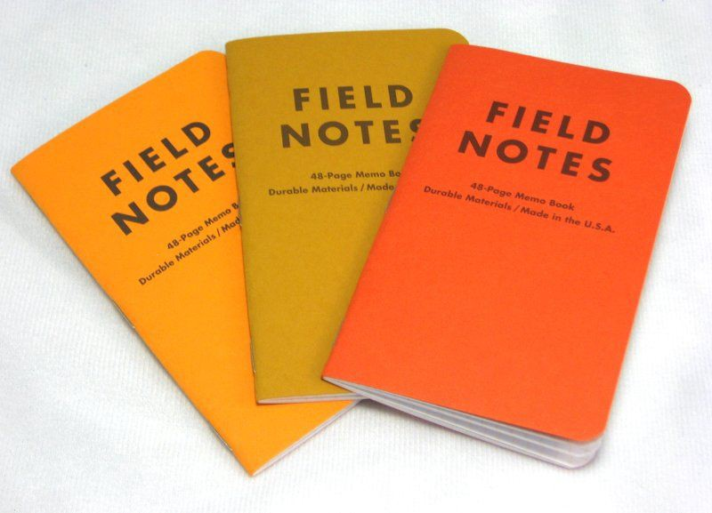
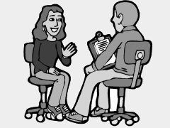

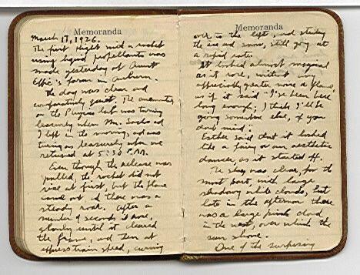


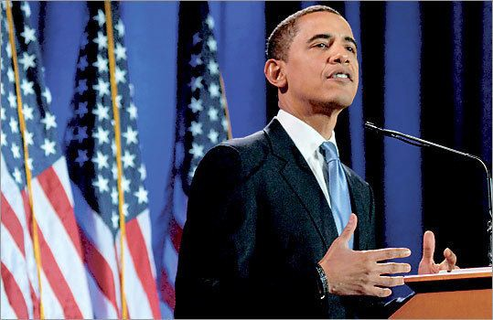
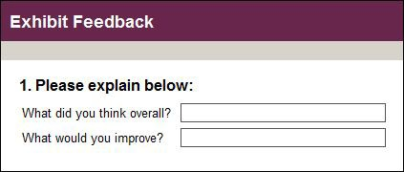
Text as data

Slide 12
Types of languages
Natural languages
Time flies like an arrow. Fruit flies like a banana.
Artificial languages
Y = f3₀ + f3₁ X₁ + f3₂ X₂ + f3₃ X₃ + . . . + f3_{n} X_{n} + E
import scipy
from scipy import sparse
n = 200000
matrix = scipy.sparse.rand(n, n, density=.001)
print(matrix)

Slide 13

How do humans analyze texts?
…as President, I can’t be locked in a room someplace for the next year and just stay and do nothing. And every time I go into a crowd, I was with the parents of our fallen heroes… And they came up to me and they would hug me… and I’m not to not let them do it, to be honest with you.
Donald Trump (Oct. 15, 2020)
Close reading
Notes:
Another great Trump quote:
People want the border wall. My base definitely wants the border wall, my base really wants it — you’ve been to many of the rallies. OK, the thing they want more than anything is the wall. My base, which is a big base; I think my base is 45 percent. You know, it’s funny. The Democrats, they have a big advantage in the Electoral College. Big, big, big advantage. … The Electoral College is very difficult for a Republican to win, and I will tell you, the people want to see it. They want to see the wall.
An Obama quote:
We need to steer clear of this poverty of ambition, where people want to drive fancy cars and wear nice clothes and live in nice apartments but don't want to work hard to accomplish these things. Everyone should try to realize their full potential.

Slide 14
The promise of distant reading
Scale/speed
Reproducibility
Does not have human biases
Has other (at times unknown) biases
Consistent

Slide 15
A simple representation of text
Corpus of documents
Objective: map raw text of each document i to some attribute v_{i}
The estimated attribute vˆ_{i} can then be used for descriptive or causal analysis
Notes:
Slide borrowed from David Bamman’s INFO 256 course: http://people.ischool.berkeley.edu/~dbamman/info256.html

Slide 16
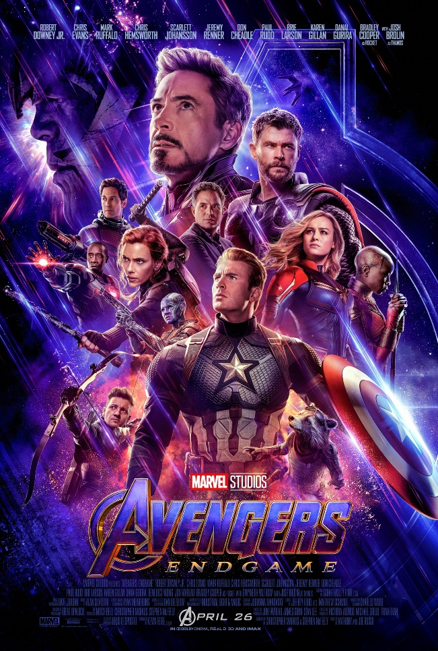
Movie revenues
Input: text of movie review
Output: box office revenue
Joshi et al. (2010), "Movie Reviews and Revenues: An Experiment in Text Regression” (NAACL)
Notes:
Slide borrowed from David Bamman’s INFO 256 course: http://people.ischool.berkeley.edu/~dbamman/info256.html

Slide 17
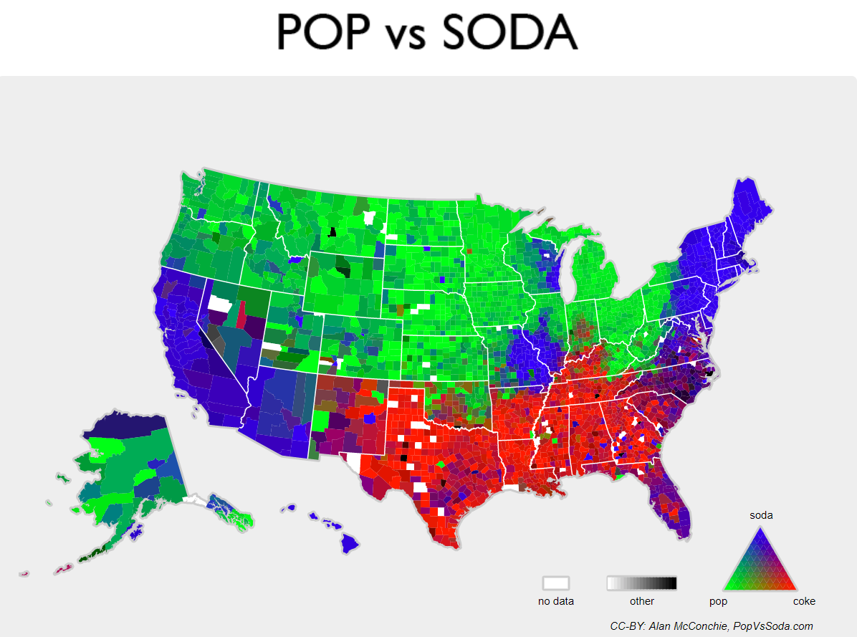
Geographical location
Input: tweet
Output: latitude, longitude
http://popvssoda.com
Wing and Baldridge (2011), “Simple supervised document geolocation with geodesic grids” (ACL)
Notes:
Slide borrowed from David Bamman’s INFO 256 course: http://people.ischool.berkeley.edu/~dbamman/info256.html

Slide 18

•
Data: Random acts of pizza (subreddit)
•
Response: Is a request successful in getting a pizza?
Althoff et al. (2014), "How to Ask for a Favor: A Case Study on the Success of Altruistic Requests” (ICWSM)
Notes:
Slide borrowed from David Bamman’s INFO 256 course: http://people.ischool.berkeley.edu/~dbamman/info256.html

Slide 19
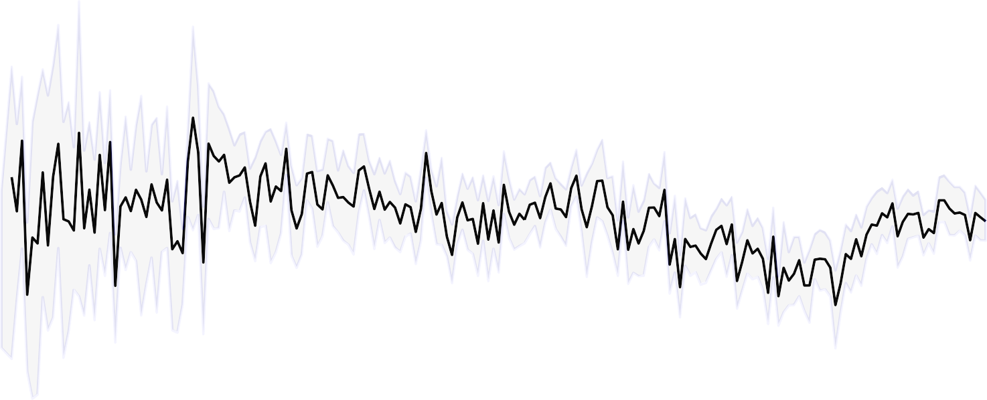
1.00
0.75
words about women
0.50
written by women
0.25
0.00
1820
1840
1860
1880
1900
1920
1940
1960
1980
2000
Fraction of words about female characters
Ted Underwood, David Bamman, and Sabrina Lee (2018), "The Transformation of Gender in English-Language Fiction,” (Cultural Analytics)
Notes:
Slide borrowed from David Bamman’s INFO 256 course: http://people.ischool.berkeley.edu/~dbamman/info256.html

Slide 20
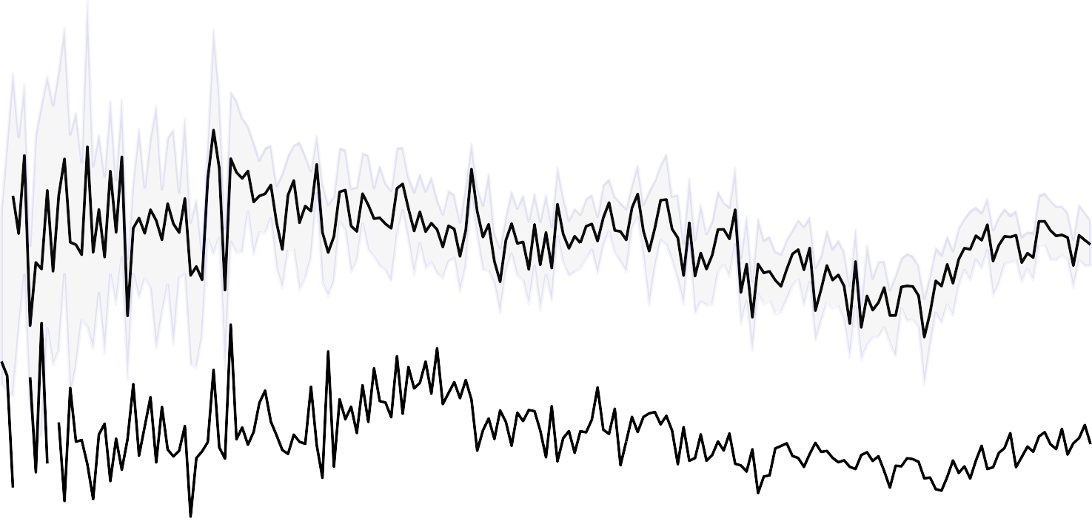
1.00
0.75
words about women
0.50
written by women
written by men
0.25
0.00
1820
1840
1860
1880
1900
1920
1940
1960
1980
2000
Fraction of words about female characters
Ted Underwood, David Bamman, and Sabrina Lee (2018), "The Transformation of Gender in English-Language Fiction,” (Cultural Analytics)
Notes:
Slide borrowed from David Bamman’s INFO 256 course: http://people.ischool.berkeley.edu/~dbamman/info256.html

Slide 21
CTA lifecycle

Slide 22
NLP research design
Research question
Collect data
Preprocessing
Modeling
Interpret
Notes:
Cooking analogy:
RQ = what you want to eat
Data collection = buying it from store, hunting, etc.
Preprocessing = remove from packaging, set up cutting board, etc.
Modeling = chop, apply heat, etc.
Interpretation = eat it! The experience you originally sought

Slide 23


NLP research design
Research question
Collect data
Preprocessing
Modeling
Interpret
Notes:
Cooking analogy:
RQ = what you want to eat
Data collection = buying it from store, hunting, etc.
Preprocessing = remove from packaging, set up cutting board, etc.
Modeling = chop, apply heat, etc.
Interpretation = eat it! The experience you originally sought

Slide 24
Research question
Research question
Domain specific
Possible answer is encoded in text
- E.g. What are the early warning symptoms of depression?
How did different European nations react to the election of Trump?
Do Twitter users react differently to mass shootings based on the ethnicity of the perpetrator?
What distinguishes different styles of hip-hop?
Have any of these essays been plagiarized?

Slide 25
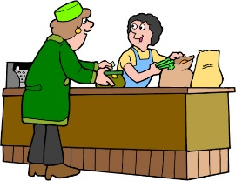
NLP research design
Research question
Collect data
Preprocessing
Modeling
Interpret
Notes:
Cooking analogy:
RQ = what you want to eat
Data collection = buying it from store, hunting, etc.
Preprocessing = remove from packaging, set up cutting board, etc.
Modeling = chop, apply heat, etc.
Interpretation = eat it! The experience you originally sought

Slide 26
Getting data
Collect data
What do we want?
- Plain, machine-readable text
How do we get it?
You (your collaborator or a stranger on the Internet) already have it*
Web scraping
API
OCR
- *Still important to know how the data was collected

Slide 27

NLP research design
Research question
Collect data
Preprocessing
Modeling
Interpret
Notes:
Cooking analogy:
RQ = what you want to eat
Data collection = buying it from store, hunting, etc.
Preprocessing = remove from packaging, set up cutting board, etc.
Modeling = chop, apply heat, etc.
Interpretation = eat it! The experience you originally sought

Slide 28
What is preprocessing?
Preprocessing
Tokenization = separating running text into words
Sentence segmentation/tokenization = separating words into sentences
Text normalization = dealing with upper/lower case, spelling mistakes, removing special characters, replacing URLs, numbers, etc.
Remove “stop words”
Stemming/lemmatization = removing morphological affixes
POS tagging = assigning a part-of-speech category to each word
Syntactic parsing = assigning a (normally graph or tree) structure to a sentence
Chunking = shallow version of syntactic parsing
Named entity recognition = identifying the proper nouns in a text
- . . .

Slide 29
Why do we do preprocessing?
Preprocessing
Because later methods require preprocessed data as input
Counting words requires having already identified the words of a text
Knowing the POS of a word might help us in knowing whether it is important (modal can vs noun
can)
Because we gain intuition about our data
It forces us to look at the data
Often coupled with exploratory data analysis (EDA)
We might find out that all the reviews are exactly 500 characters long, which suggests some have been truncated.

Slide 30
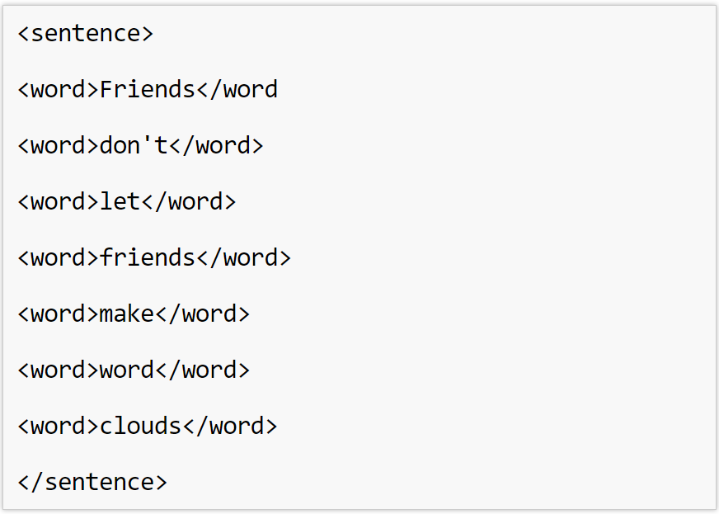
Tokenization
Preprocessing

Slide 31
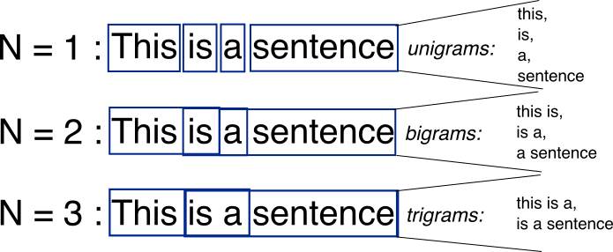
What are N-grams?
Preprocessing
Notes:
Text = document, a single unit under study
Corpus = a collection of documents
Lexical ≈ fancy name for word
N-gram: sequences of adjacent words of length N
Bag of words

Slide 32
Document-term matrix
Preprocessing
 | Hamlet | Macbeth | Romeo & Juliet | Richard III | Julius Caesar | Tempest | Othello | King Lear
knife | 1 | 1 | 4 | 2 |  | 2 |  | 2
dog | 2 |  | 6 | 6 |  | 2 |  | 12
sword | 17 | 2 | 7 | 12 |  | 2 |  | 17
love | 64 |  | 135 | 63 |  | 12 |  | 48
like | 75 | 38 | 34 | 36 | 34 | 41 | 27 | 44
Context = appearing in the same document.
Notes:
Document-Term Matrix (DTM)
Words are rows, documents are columns, entries are number of times word appears in document.
DTM: Vector representation that encodes information about the distribution of contexts a word appears in
Words that appear in similar contexts have similar representations (and similar meanings, by the distributional hypothesis).

Slide 33
Document vector
Preprocessing
Vector representation of the document; vector size = V
Hamlet
1
2
17
64
75
King Lear
2
12
17
48
44

Slide 34
Word vector
Preprocessing
knife | 1 | 1 | 4 | 2 |  | 2 |  | 2
sword | 17 | 2 | 7 | 12 |  | 2 |  | 17
Vector representation of the term; vector size = number of documents

Slide 35
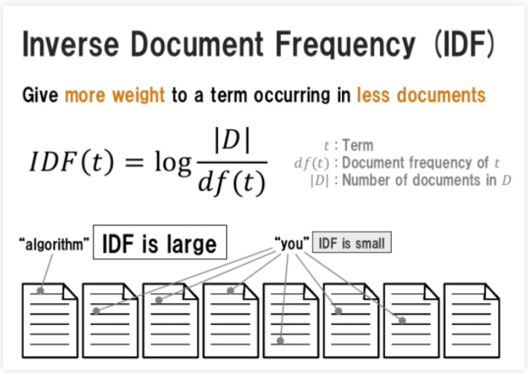
TF-IDF = Term Frequency…
Preprocessing
Notes:
TF-IDF:
Modification of DTM
Entries are scaled by how common a word is across the whole corpus

Slide 36
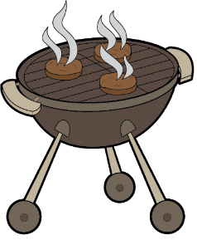
NLP research design
Research question
Collect data
Preprocessing
Modeling
Interpret
Notes:
Cooking analogy:
RQ = what you want to eat
Data collection = buying it from store, hunting, etc.
Preprocessing = remove from packaging, set up cutting board, etc.
Modeling = chop, apply heat, etc.
Interpretation = eat it! The experience you originally sought

Slide 37
Inputs to modeling
Modeling
Topic modeling: input = many different texts, output = what each text is about
Newspaper articles
Emails
Classification: input = many different texts and hand-labeled categories, output = something that can take in unlabeled texts and predict the category.
Hand label a bunch of documents, train a computer to mimic your hand coding
Spam / ham
positive/negative reviews
The big difference is the need for labeled data (unsupervised vs supervised)
Text = document, could be a review, newspaper article, journal article, whole book, tweet, . . .

Slide 38
Notes:
Slide from Jurafsky & Manning’s online course onNLP

Slide 39
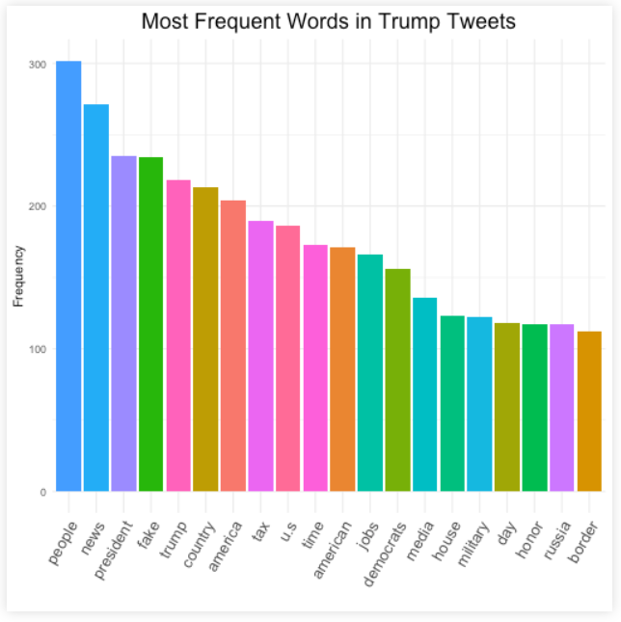
Frequent words
Notes:
This is still bag of words, and not quite a model—but useful first lens into data

Slide 40
Common NLP modeling methods
Modeling
Dictionary methods
Lists of positive/negative words (sentiment analysis)
Distinctive words
Through difference of proportions, Chi-square test, classification, etc.
Classification
Use text features to sort into categories, e.g. spam/not spam
Topic modeling
Mixture of words over topics and topics over documents
Word embeddings
Each word represented by numerical vector
Clustering
Of DTM or TF-IDF, or topics, or word embeddings

Slide 41
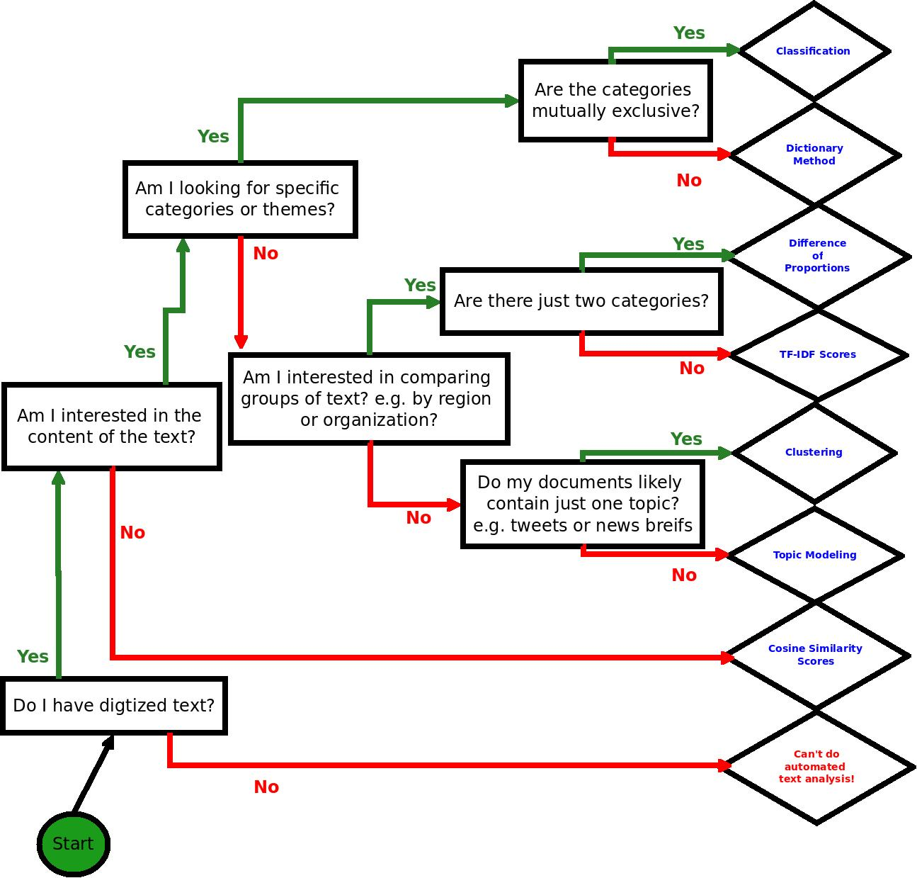
Modeling
Thanks to Laura K Nelson
Notes:
Your first decision, can I do automated text analysis? It requires digitized text.
Cosine similarity just checks how similar the corpora are – useful for plagiarism checking. If the number is near zero, someone plagiarized
Second question, do I want to do deductive or inductive analysis?

Slide 42
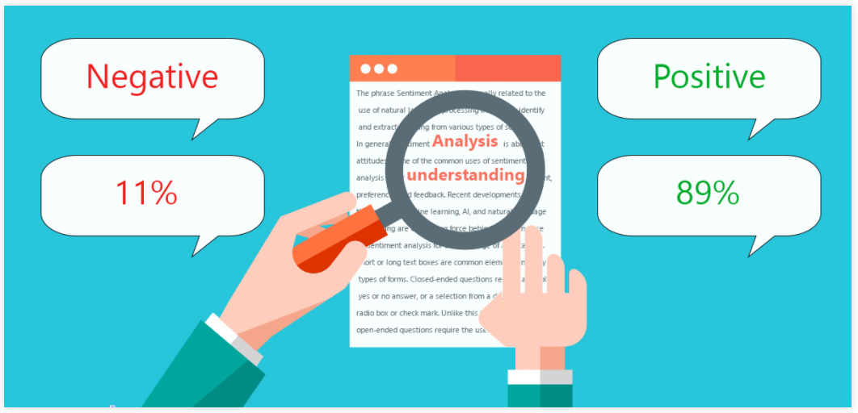
Dictionary method
Modeling

Slide 43
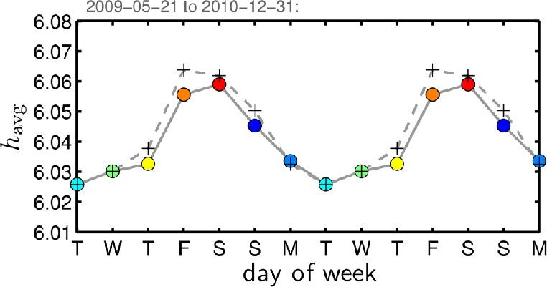
Dictionary method
Modeling
Dodds et al. (2011), "Temporal patterns of happiness and information in a global social network: Hedonometrics and Twitter" (PLoS One)

Slide 44
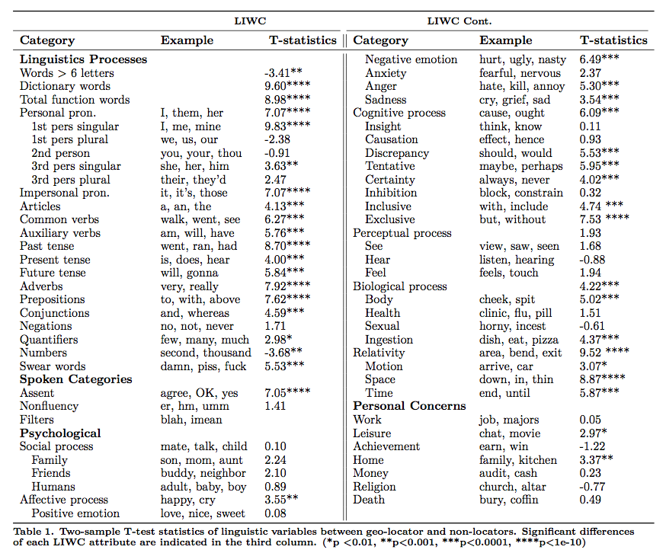
Modeling

Slide 45
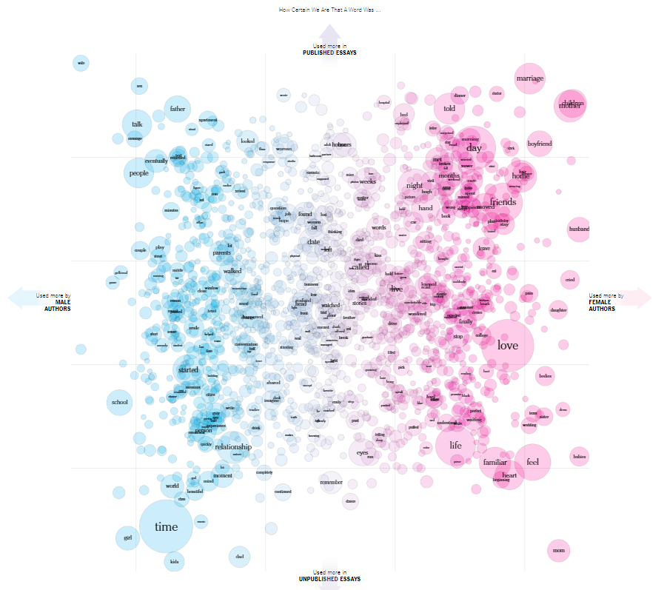
Modeling
Distinctive words
https://www.nytimes.com/interactive/2017/11/07/upshot/modern-love-what-we-write-when-we-write-about-love.html
Notes:
Finding distinctive terms is useful:
As a data exploration exercise to understand larger trends in individual word differences).
As a pre-processing step of feature selection.
When the two datasets are A and ¬A, these terms also provide insight into what A is about.
Many methods for finding these terms! (Developed in NLP, corpus linguistics, political science, etc.)
Slide borrowed from David Bamman’s INFO 256 course: http://people.ischool.berkeley.edu/~dbamman/info256.html

Slide 46
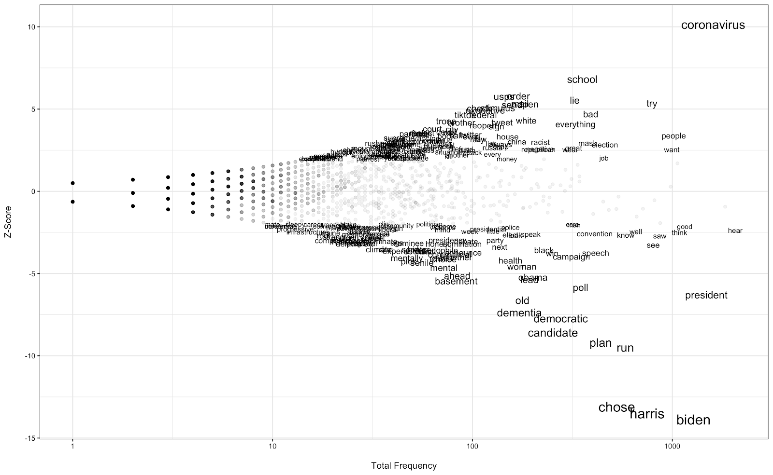
Modeling
http://smrconverge.org/blog-post/election-2020-what-words-are-defining-trump-and-biden/
Notes:
I am using the x-axis to denote overall popularity of the word in our surveys. On the y-axis, I am providing the z-score. Note that words with z-scores in the range of [-1.96, 1.96] are only represented by a dot in this plot, for ease of viewing. Such words are not significantly unique to one corpus. A couple of insights get revealed immediately. First, we observe that coronavirus is top-of-mind for respondents when talking about Trump. VP pick is top-of-mind for Biden. We also see a distinction between the negative topics that stuck for the two candidates. While words like “old” and “dementia” are more uniquely associated with Biden, words like “lie” and “racist” are associated with Trump. One other point to keep in mind: respondents are referring to Biden by name when discussing the candidate while this is not as common for Trump. Indeed, the z-score for “trump” was negative (though not significant). Meaning that that word was more commonly seen in responses given about Biden. This could be because the respondents are more concerned about Trump and are focusing on these concerns when discussing Biden.

Slide 47
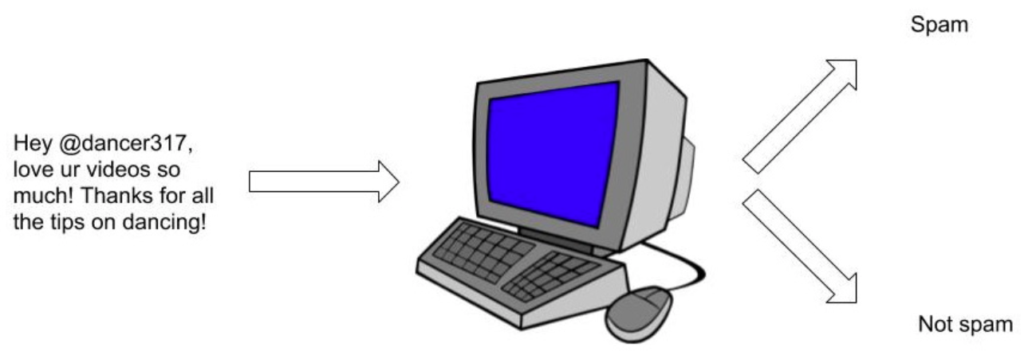
Modeling
Classification
Notes:
Thanks Geoff Bacon for this visual

Slide 48
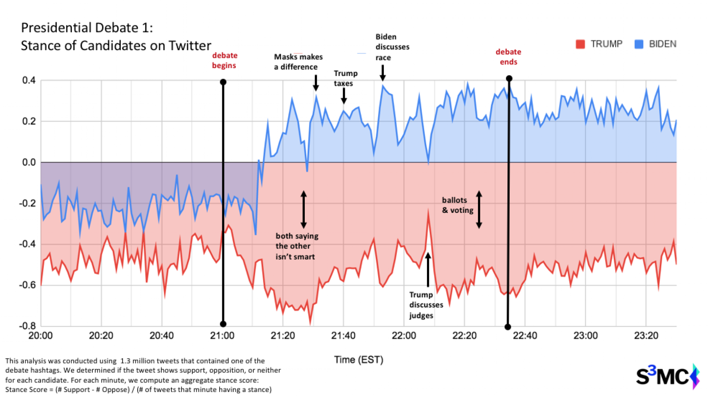
Modeling
Classification
https://mccourt.georgetown.edu/news/presidential-debate-candidate-stance-analysis/

Slide 49
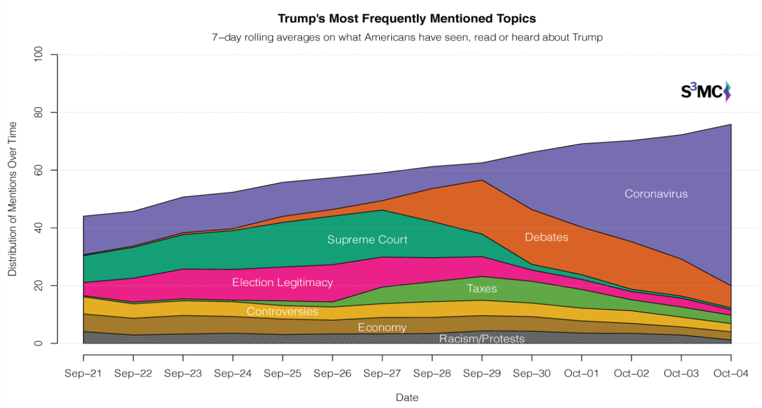
Modeling
Topic modeling
https://www.cnn.com/2020/10/08/politics/the-breakthrough-trump-biden-coronavirus-debate/index.html

Slide 50
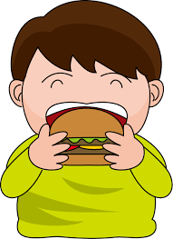
NLP research design
Research question
Collect data
Preprocessing
Modeling
Interpret
Notes:
Cooking analogy:
RQ = what you want to eat
Data collection = buying it from store, hunting, etc.
Preprocessing = remove from packaging, set up cutting board, etc.
Modeling = chop, apply heat, etc.
Interpretation = eat it! The experience you originally sought

Slide 51
What you’ve been after…
Interpret
Use the insight from the preprocessing and modeling stage to understand the initial question
In classification, this could be looking at words with high coefficients.
E.g. People with depressive symptoms are more likely to talk about abstract concepts and use more negation.
In topic modeling, this could be qualitative inspection of the topics.
E.g. In Germany the main themes centered around taxes and immigration, while in France people were more concerned about racism.

Slide 52
To review…
Research question
Collect data
Preprocessing
Modeling
Interpret
Notes:
Cooking analogy:
RQ = what you want to eat
Data collection = buying it from store, hunting, etc.
Preprocessing = remove from packaging, set up cutting board, etc.
Modeling = chop, apply heat, etc.
Interpretation = eat it! The experience you originally sought

Slide 53

Questions?

Slide 54
Now to get our hands dirty
http://bit.ly/nlp-repo-2020

Slide 55
Further resources
Introduction to Jupyter Notebooks (Real Python)
Quick Python intro (a Jupyter Notebook)
Great book on Python (with exercises): “Python for Everybody” (Charles Severance)
Official Python Tutorial
NLP course & scripts, for social scientists & digital humanists (Laura Nelson)
NLP textbook (Jurafsky & Martin @ Stanford)
Book on NLTK (NLTK team)
Datasets for NLP (Hugging Face)
Intro to SpaCy and NLP concepts (Allison Parrish)
Workshops on NLTK and SpaCy (Geoff Bacon @ D-Lab)

Slide 56
Further examples of CTA applications
Estimate political ideology from Twitter
Uncover government censorship
Relate the stock market to sentiment in the media
Study why particular papers get cited
Detect impending disease epidemics
Determine who actually wrote something
- . . .

